Slide 1

CAPSTONE PROJECT
TOBI Automation Testing Tool
FPT UNIVERSITY | HOA LAC | SPRING 2019

Slide 2

TOBI Automation Testing Tool
TOBI Team Member
GiangNT
Member
AnhBN
Supervisor
TuPA
Member
HauLV
Team Leader
LamNN
Member
DongND
Member

Slide 3




TOBI Automation Testing Tool
Supervisor
&
Stakeholder
Bui Ngoc Anh
Nguyen Chanh Tin
Nguyen Dinh Dan
Nguyen Manh Hieu
Supervisor
BUL
Vice BUL
BA Leader & End-user

Slide 4
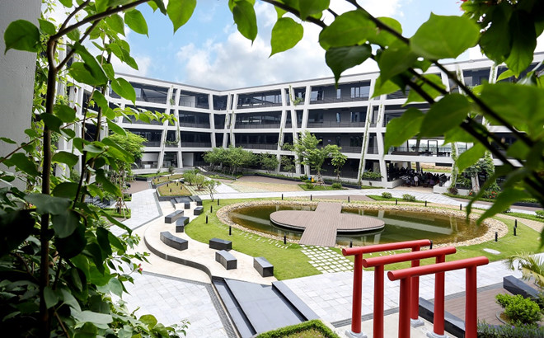
OUTLINE OF PRESENTATION
01
Project Overview
02
TOBI Automation Testing Tool
Project Management
03
Software Requirement
Specification
04
Software Design
05
Testing
06
Lesson Learned
07
Demo & QA

Slide 5
PROJECT OVERVIEW

Slide 6
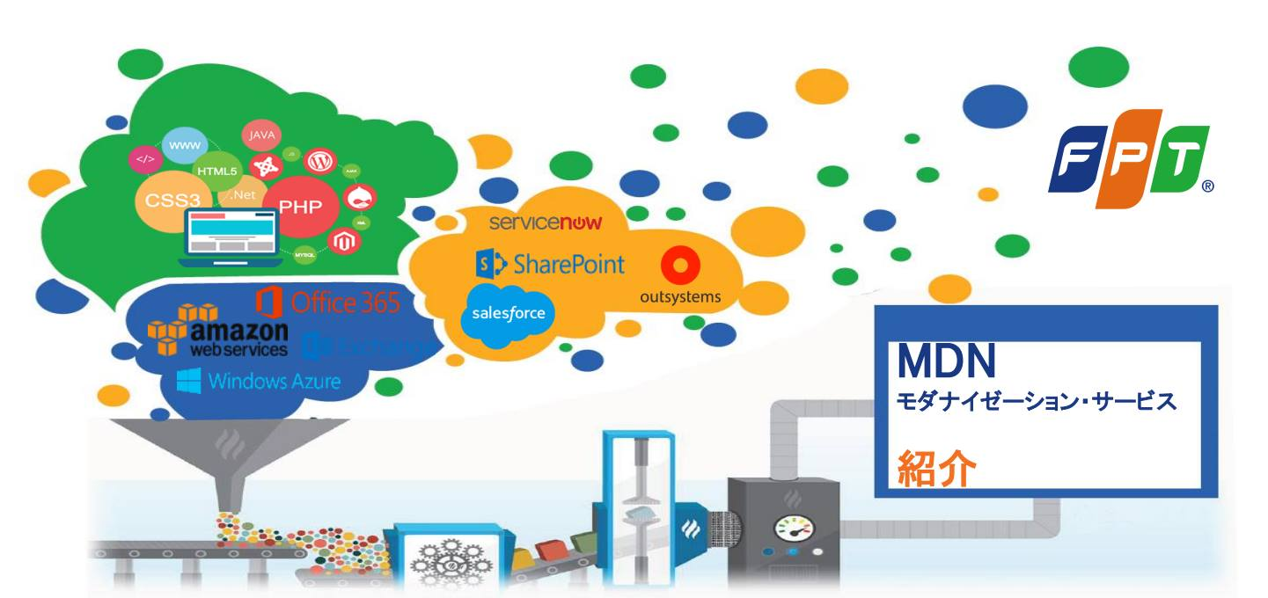
BACKGROUND

Slide 7



EXISTING SYSTEMS

Slide 8
COMPARISON
 | TOBI Tool | Katalon Studio | TestComplete
Show differences between image pair | ✔ | X | ✔
Compare Image Folders | ✔ | X | X
Project Explorer (IDE-like) | ✔ | ✔ | ✔
Price (free) | ✔ | ✔ | X
Migration Test | ✔ | X | X
Automatic image accuracy check | ✔ | X | ✔

Slide 9
TOBI TOOL
R&D
- Preliminary Investigation
- System Analysis
System design
- External Design
- Internal Design
Software Construction
- Coding
- Migration
Testing
- UT report
Tool support evaluate difficult of each screen/item
Tool support check format/true value of some special data
Tool pattern convert
Tool Automation Test UI
Tool support est time
Tool support generate data test/develop
Review UT report
Tool support check/review code
Synthetic/Analysis test case
Tool support manual convert
Tool support build/compiler audit version

Slide 10
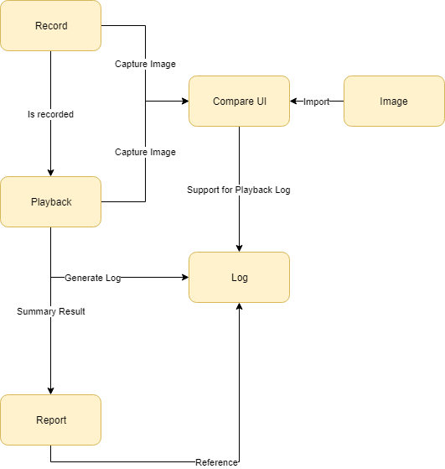
MAIN FEATURES

Slide 11
PROJECT MANAGEMENT

Slide 12
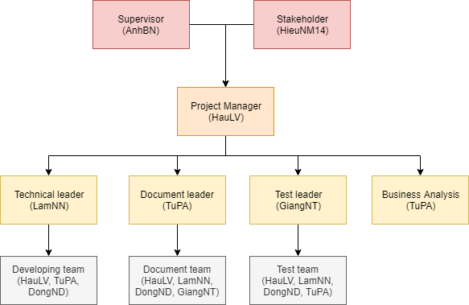
TEAM ORGANIZATION

Slide 13
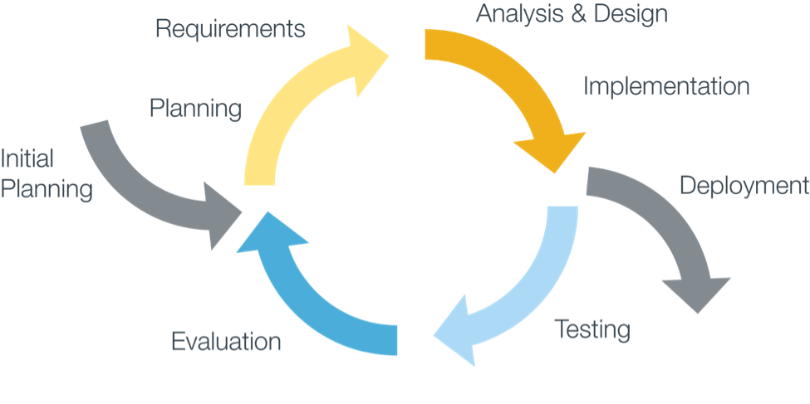
SOFTWARE MODEL PROCESS

Slide 14






COMMUNICATION PLAN
Time average: 4 hours per day and 5 days per week.
Location: 3th Floor Soc Son Dist., Fville 2, Hoa Lac.
Meeting with supervisor: At least once per week.
Team building: Once or twice per month, on the weekend.
Communication channels:
Face-to-face meeting.
E-mail, Excel Sheets: Tracking and saving important tasks and information.
Skype, Slack: Online meeting.
Facebook Messenger, mobile phone: Chatting and informal conversations.

Slide 15
COMMUNICATION MATRIX
Communication Type | Objective | Medium | Frequency | Audience | Owner | Deliverable | Format
Kickoff Meeting | Discuss and agree on project objective, and scope | Face to face | Once (when the project start) | Instructor Project team | PM | Meeting Minutes | Microsoft Word
Weekly Team Meeting | Review status of project. Discuss solution for any issues. Divide tasks | Face to face Conversation (Slack) | 2 times per week (1-time team member, 1 time with Supervisor) | Project team Supervisor | PM | Project schedule Divide tasks | Microsoft Word Get tasks on Excels
Project Plan Meeting | Discuss and planning project process | Face to face Conversation (Slack) | As scheduled | Project team | PM | Meeting Minutes Project Management Plan | Microsoft Word
Architecture Design Meeting | Review prototype Discuss, contribute and review System Architecture Design | Face to face Conversation (Slack) | As scheduled | Project team | Technical Leader | Meeting Minutes System Architecture Design Document | Microsoft Word

Slide 16
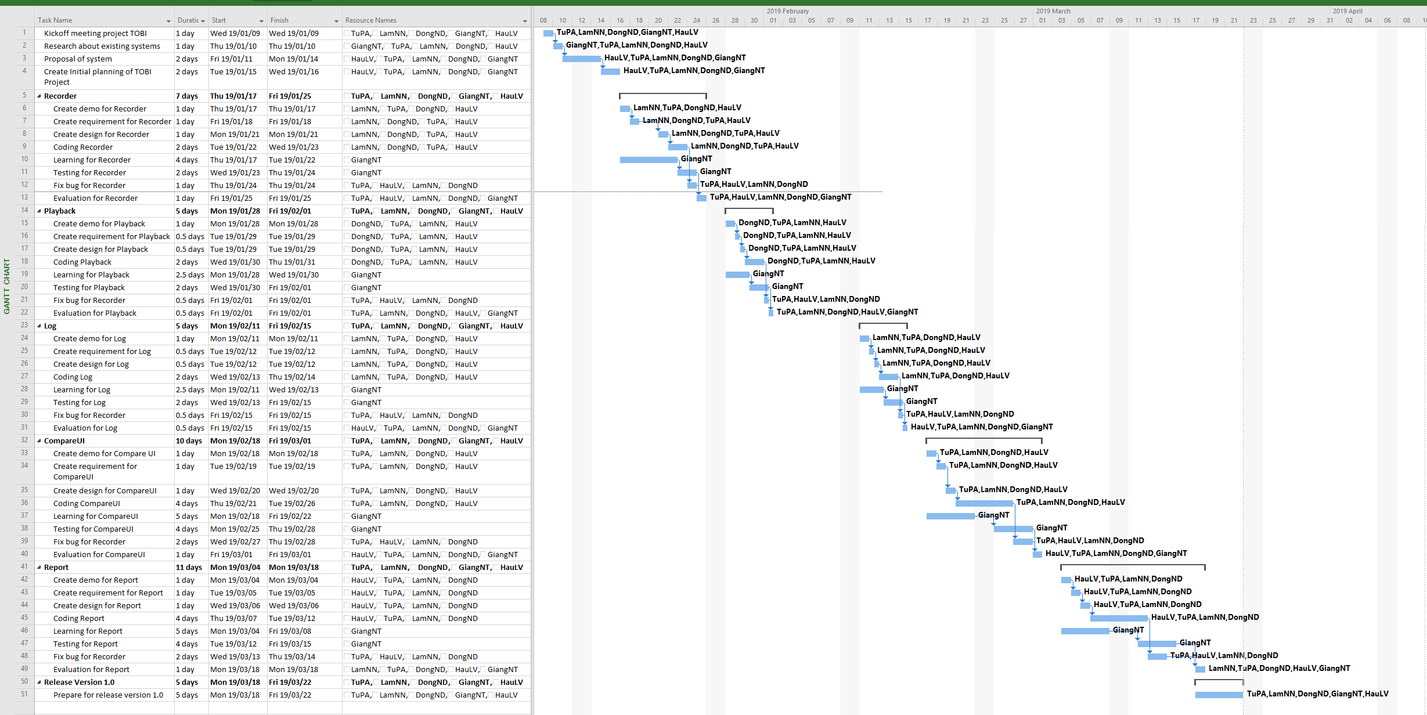
PROJECT PLAN

Slide 17
RISK MANAGEMENT
No. | Description | Avoidance plan | Contingency plan | Impact
R1 | Absence/illness of team members | Members have inform the project manager the reason why they are absent and build their own plan to keep up with the work process. | The project manager always has back up plan to avoid effect from the absence and ensure that problem will be solved. | High
R2 | Conflicts among members | At the beginning, members should clear their roles and responsibilities. | The project manager has to find out the root that caused problem and solve it. Face-to-face meeting is a good method. | Medium
R3 | Equipment of members is broken | Members must be careful with their equipment. | Members should use another equipment until the broken one is fixed or buy the new one. | Low
R4 | Business problem | Any ideas are welcome but members have to discuss with others and always focus on the reality and possibility. | Making sure that the business logic of any ideas is carefully analyzed. | High
R5 | Change management overload | Analyzing requirements carefully. | If there is a “must be changed” requirement, all team members must join the meeting to decide whether it should be implemented or not. | High

Slide 18
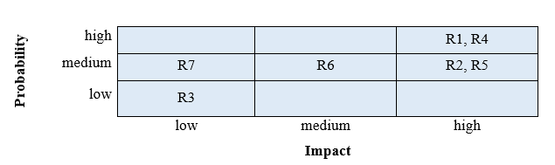
RISK PROBABILITY & IMPACT
Probability/impact matrix of risk

Slide 19












PROJECT TOOL
Visual Studio SVN Tortoise MS Outlook MS Excel Slack
Visual Studio Code Github Draw.io Astah UML
MS Project Google Drive Skype For Business Facebook Messenger

Slide 20
SOFTWARE REQUIREMENT SPECIFICATION

Slide 21
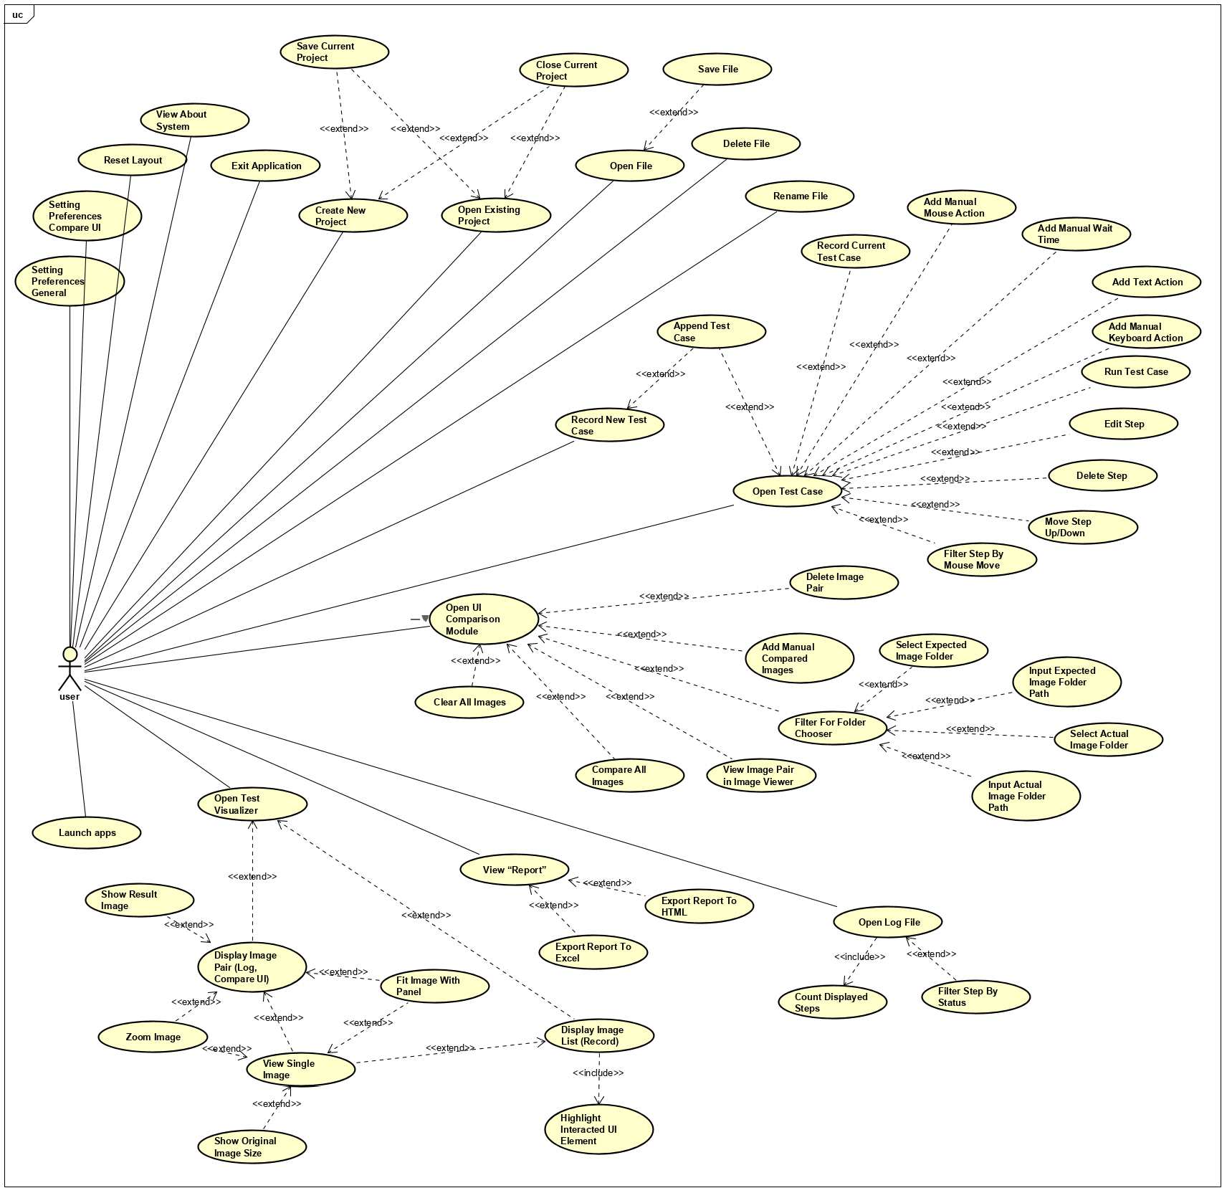
USE CASES

Slide 22
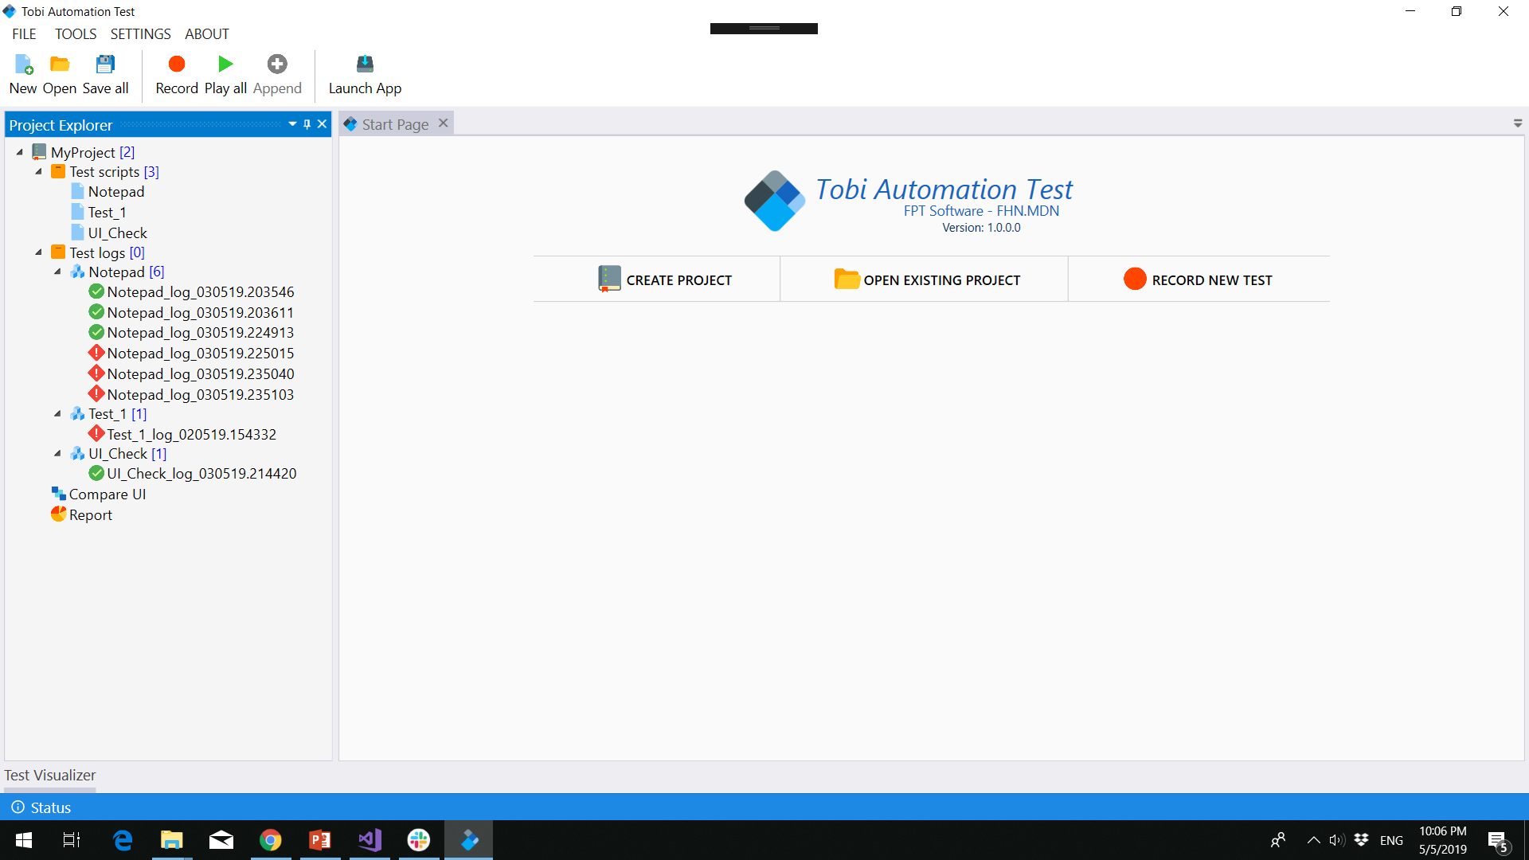
USE CASES
Open Existing Project
Open A Test Case
Open A Log
Compare UI
Report

Slide 23
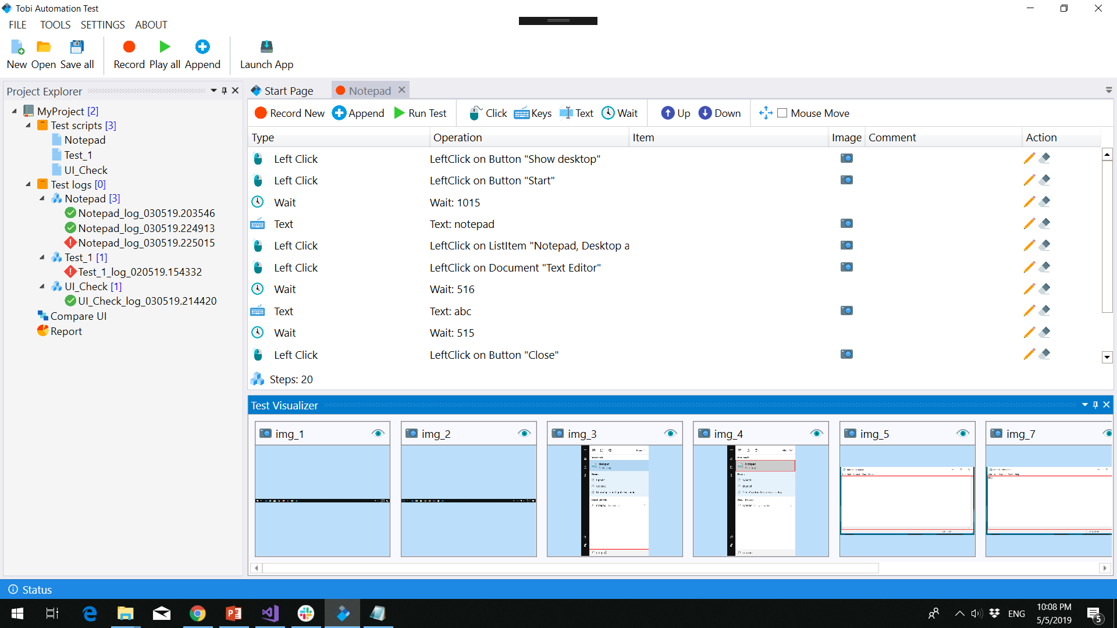
USE CASES
Open Existing Project
Open A Test Case
Open A Log
Compare UI
Report

Slide 24
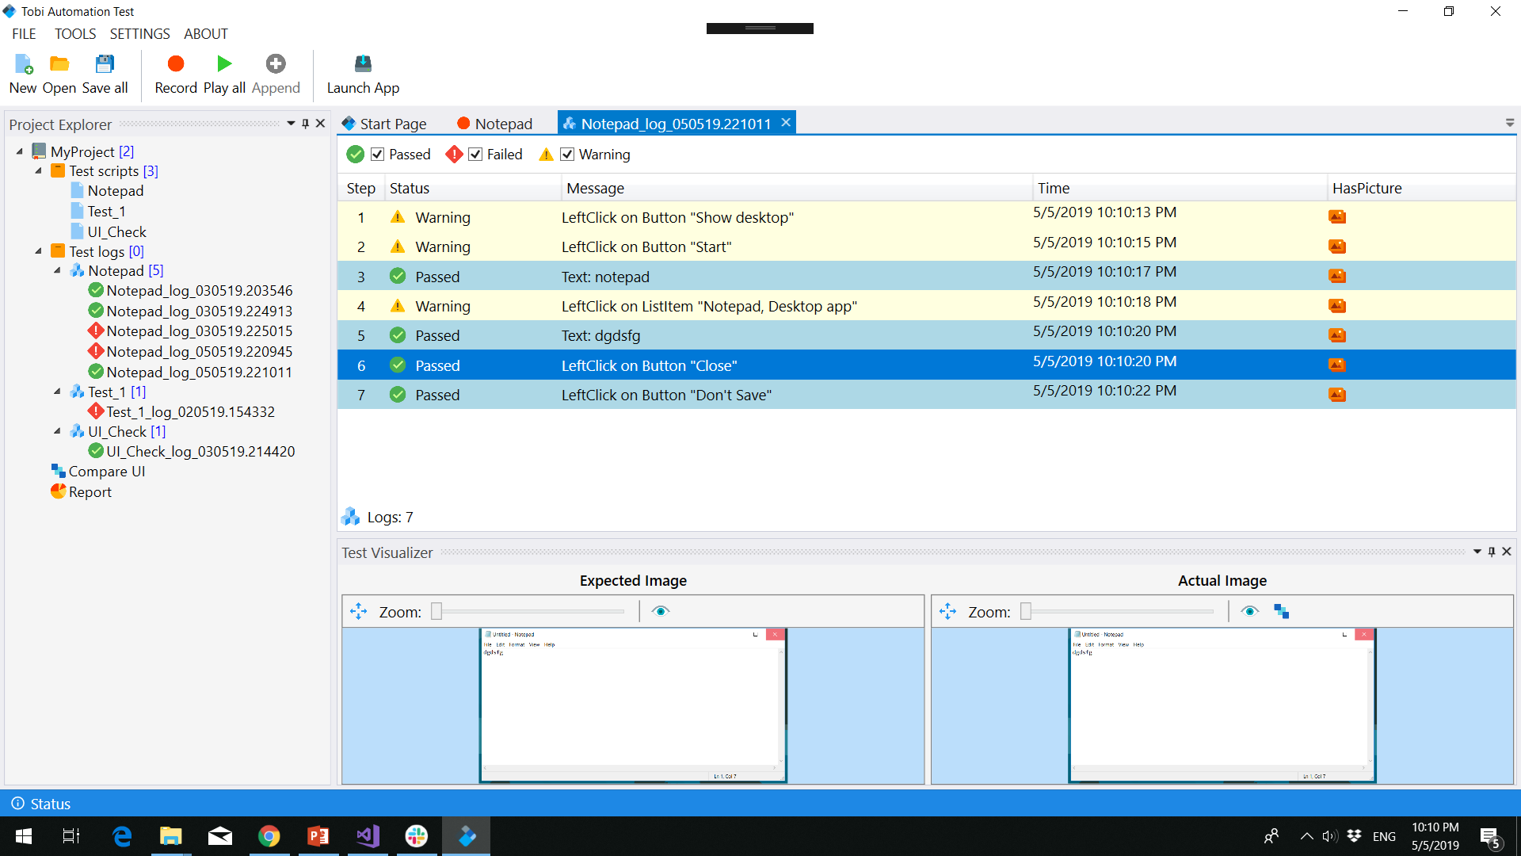
USE CASES
Open Existing Project
Open A Test Case
Open A Log
Compare UI
Report

Slide 25
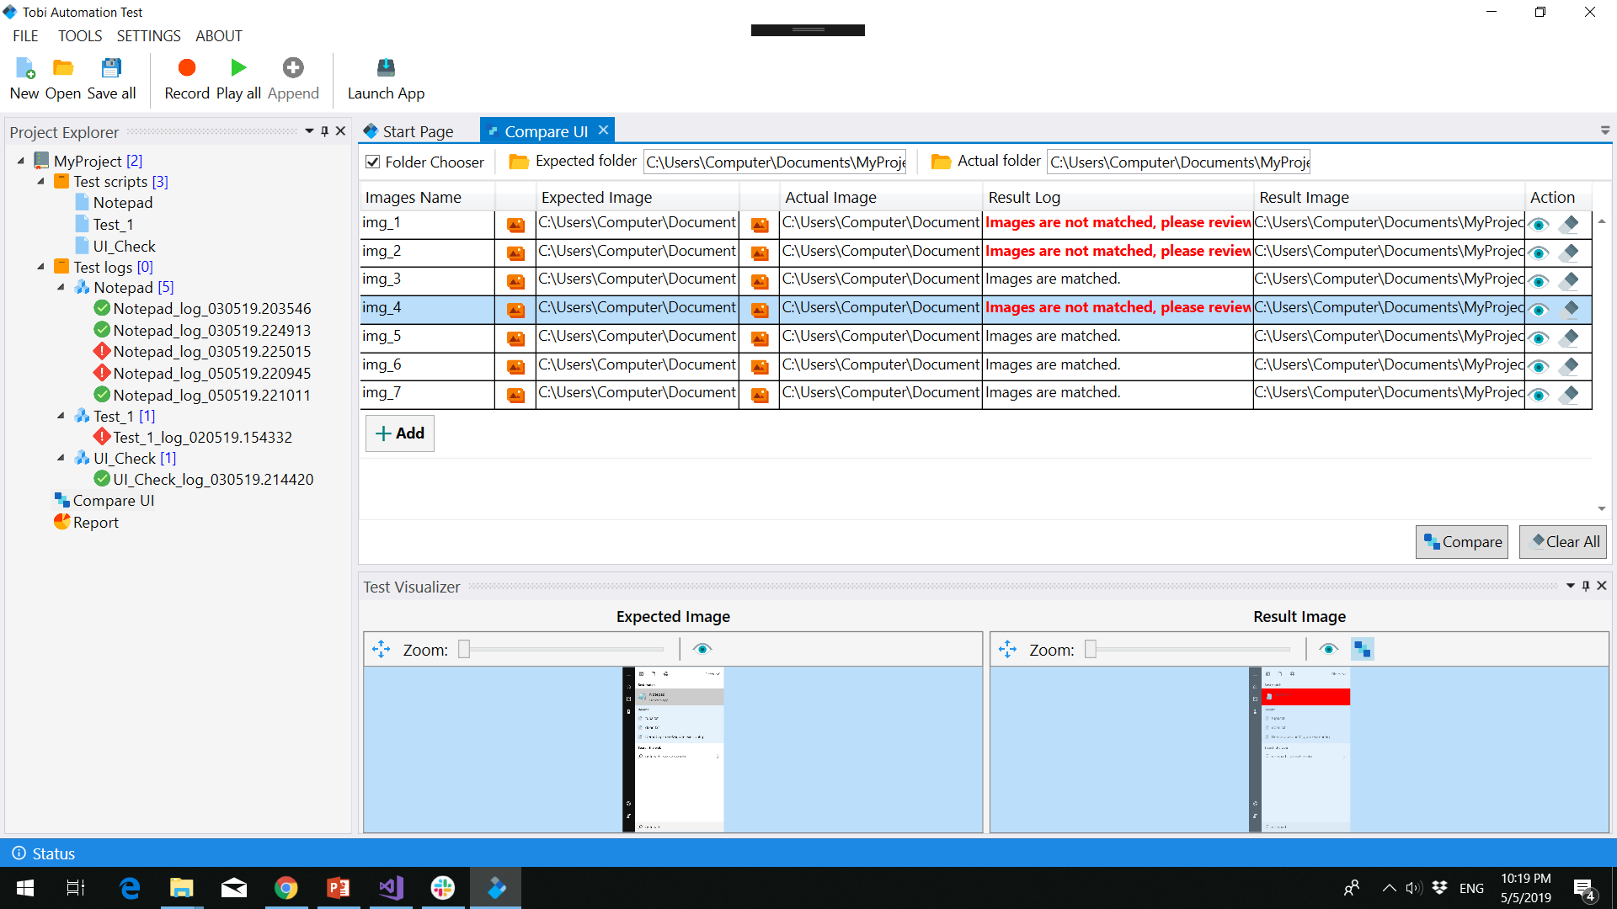
USE CASES
Open Existing Project
Open A Test Case
Open A Log
Compare UI
Report

Slide 26
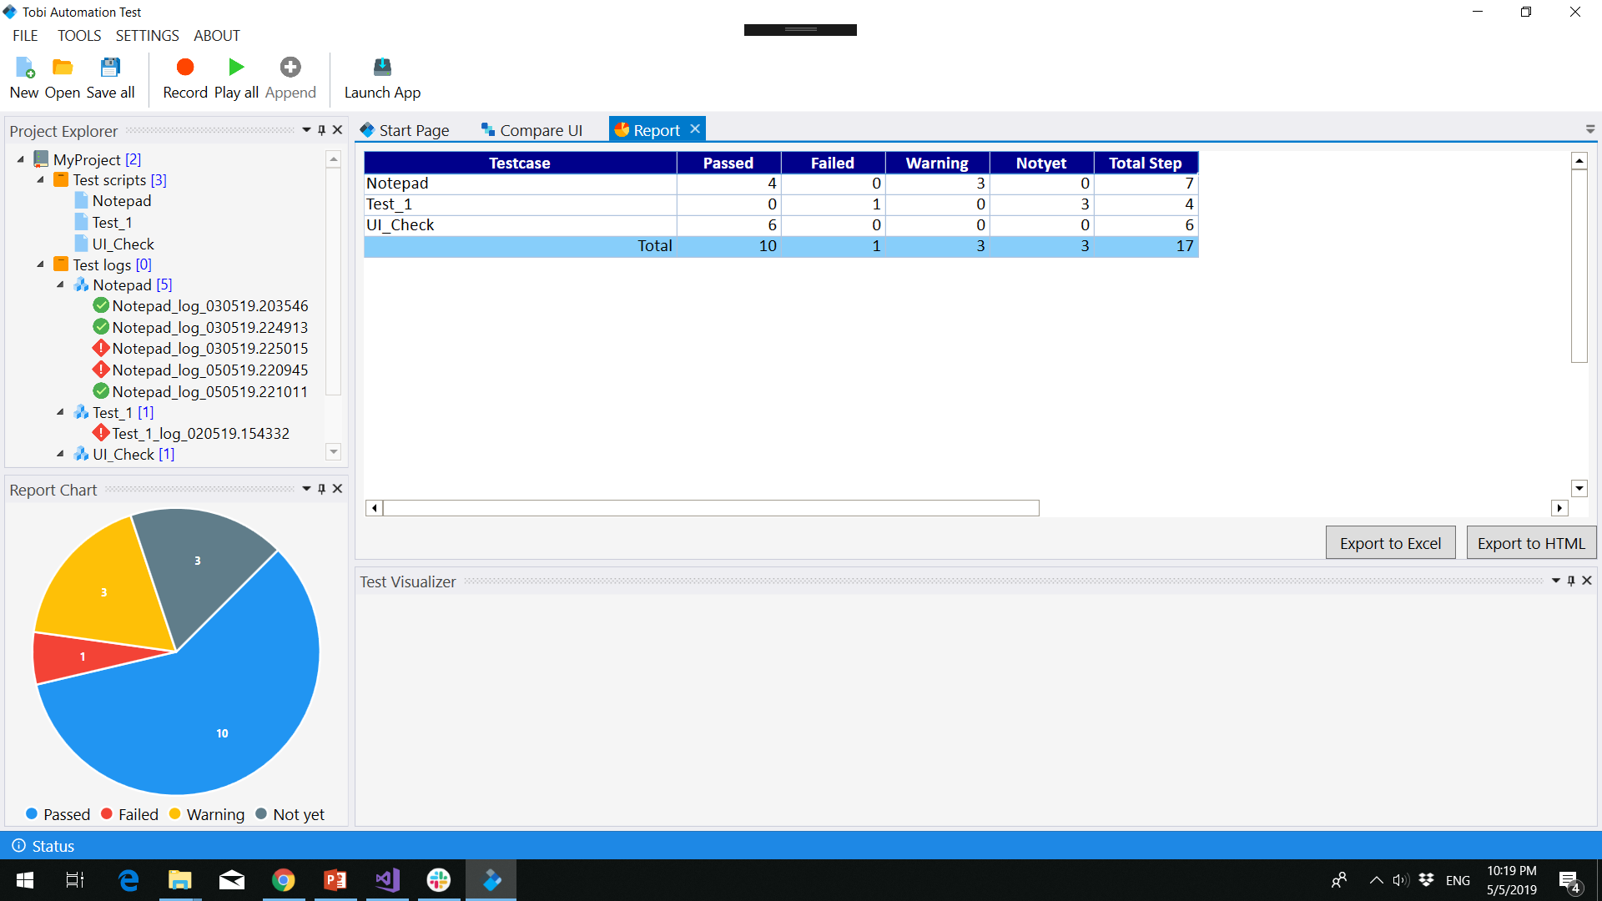
USE CASES
Open Existing Project
Open A Test Case
Open A Log
Compare UI
Report

Slide 27
SOFTWARE DESIGN

Slide 28
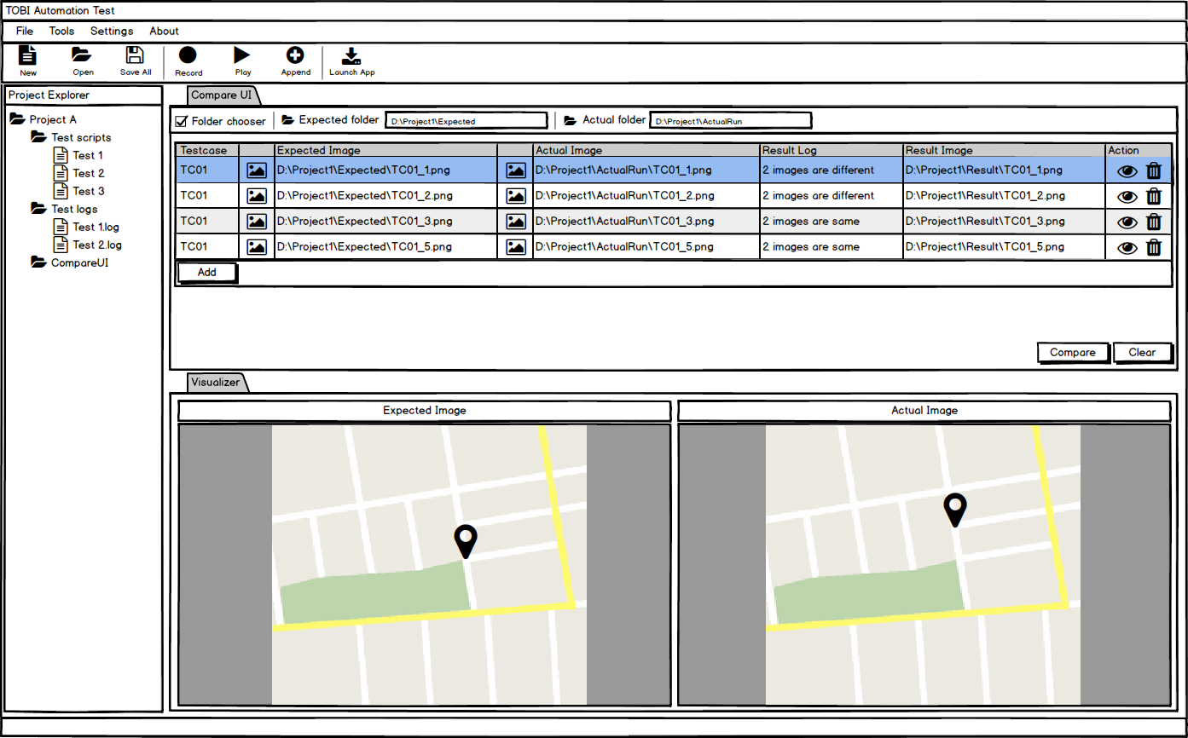
SCREEN DESIGN

Slide 29











TECHNOLOGIES
C# C++ XAML ReoGrid .NET Framework MouseKeyHook
Tesseract OCR NewtonSoft JSON FluentWPF WPF Toolkit Material Design

Slide 30
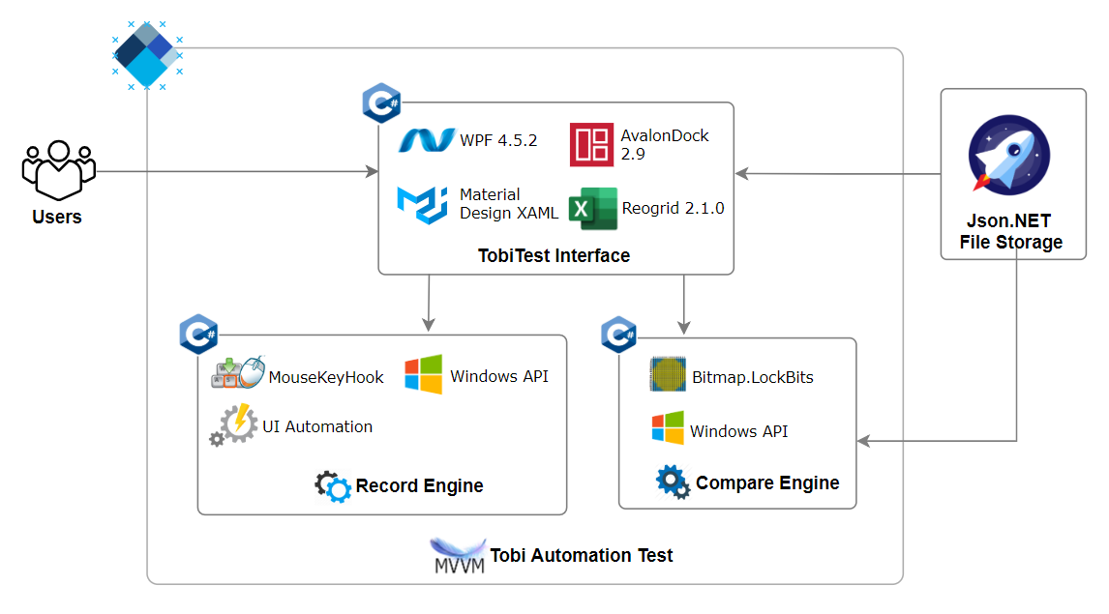
SYSTEM ARCHITECTURE

Slide 31
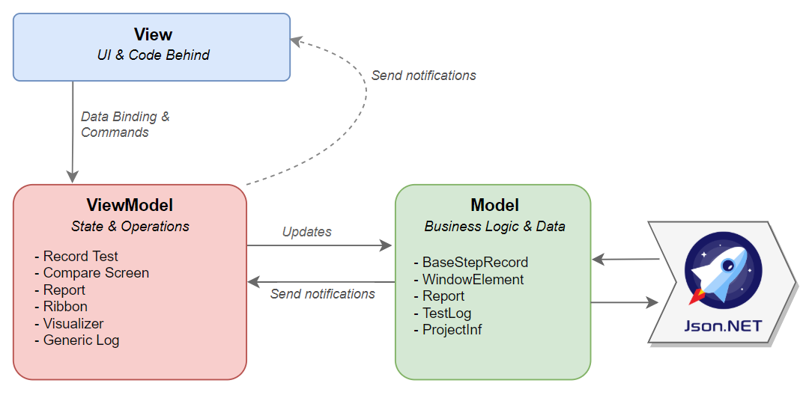
ARCHITECTURE LAYERS DESIGN
MVVM Pattern

Slide 32
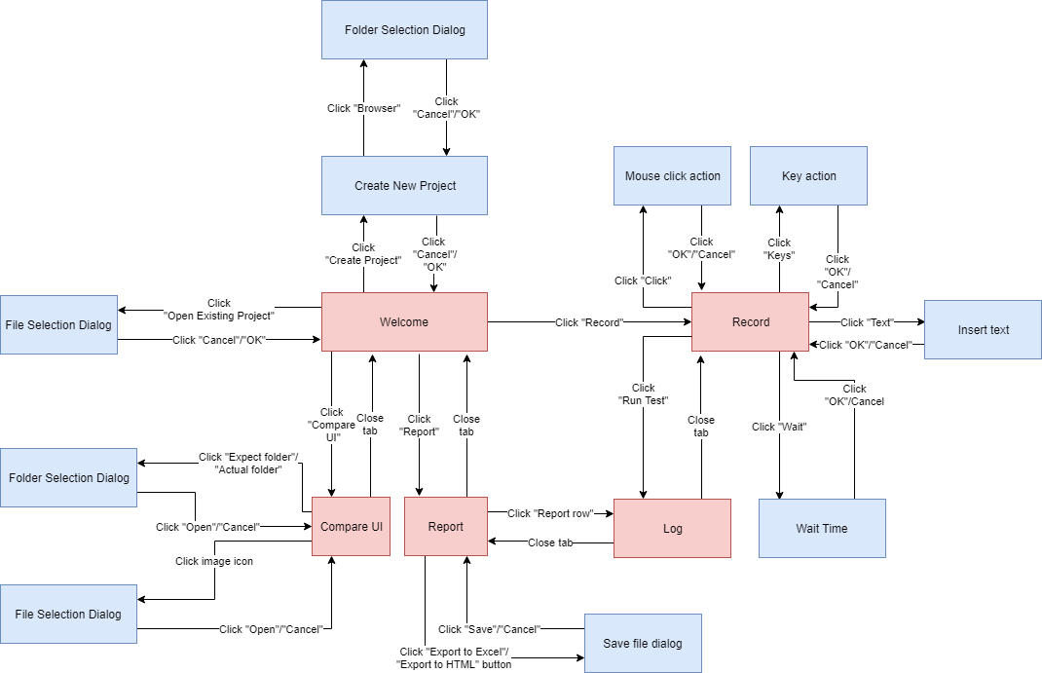
USER INTERFACE DESIGN

Slide 33
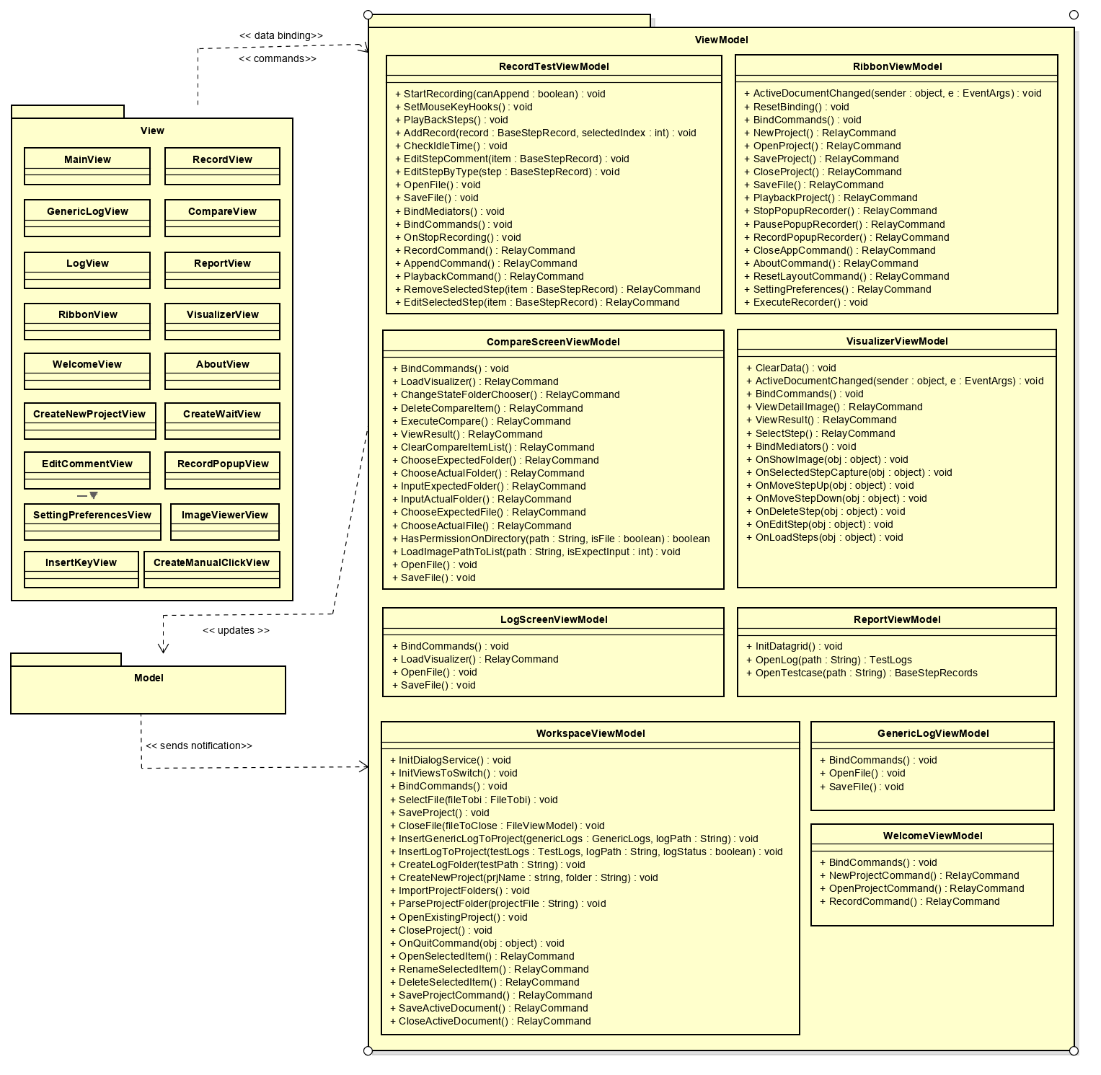
CLASS DIAGRAM
Class Diagram

Slide 34
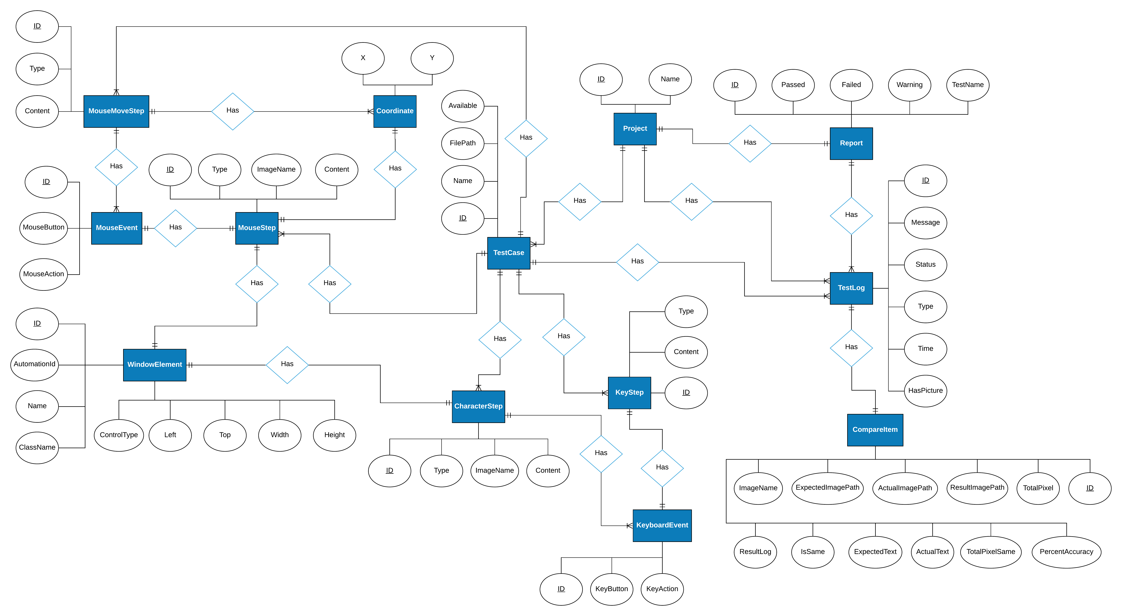
ENTITY RELATIONSHIP DIAGRAM
Entity Relationship Diagram

Slide 35
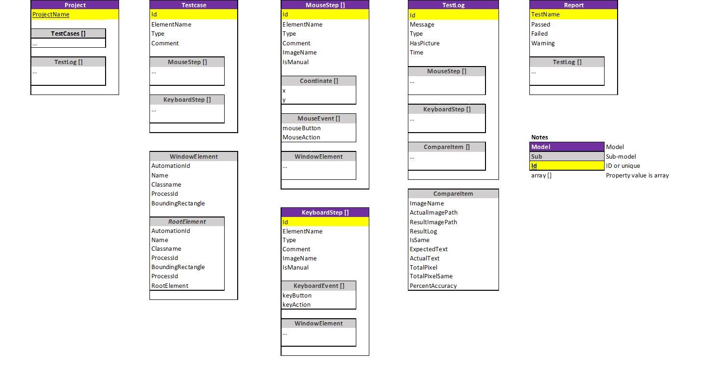
DATA STRUCTURE DESIGN

Slide 36
TESTING

Slide 37
TEST
Test plan
Testing environment
Testing tools
Iterative model
Test stage
Test Process
Test approach
Acceptance criteria
Defect log

Slide 38
TEST PLAN
Testing environment
Testing tools
Category | Test machine
OS | Windows 10,64 bit
Screen size | 15.6 inch
Screen resolution | 1366 x 768
OS Language | English
Database | N/A
Framework | .Net Framework 4.5.2
Dependency | - Microsoft Visual C++ Redistributable for Visual Studio 2017 - Install Visual Studio Build Tools
Excel is used to manage test cases and bugs
Visual Studio – MSTest to create unit tests

Slide 39
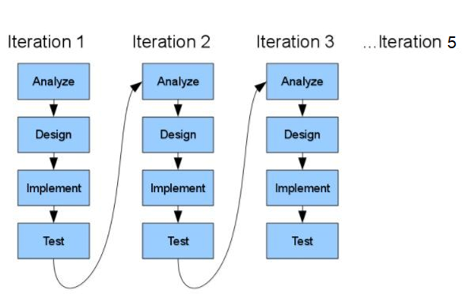
TEST PLAN
Iterative model

Slide 40
TEST PLAN
Test Stage
Types of test | Stages of test
 | Unit test | Integration test | System test | Acceptance test
Function test |  |  |  | 
Regression test |  |  |  | 
GUI test |  |  |  | 

Slide 41
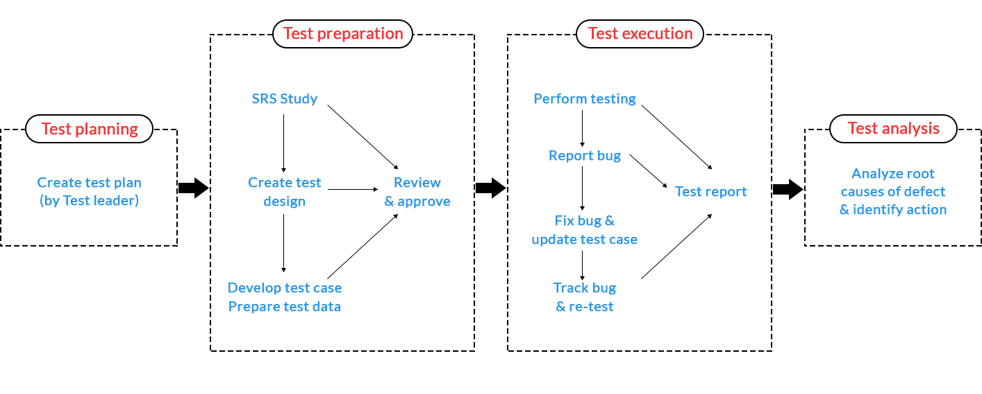
TEST PLAN
Test Process

Slide 42
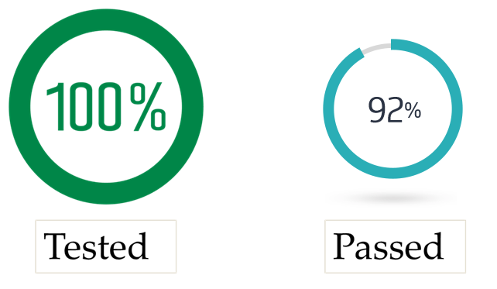
TEST APPROACH
Acceptance Criteria

Slide 43
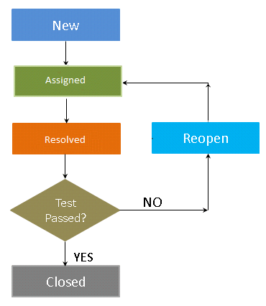
TEST APPROACH
Defects Logs

Slide 44
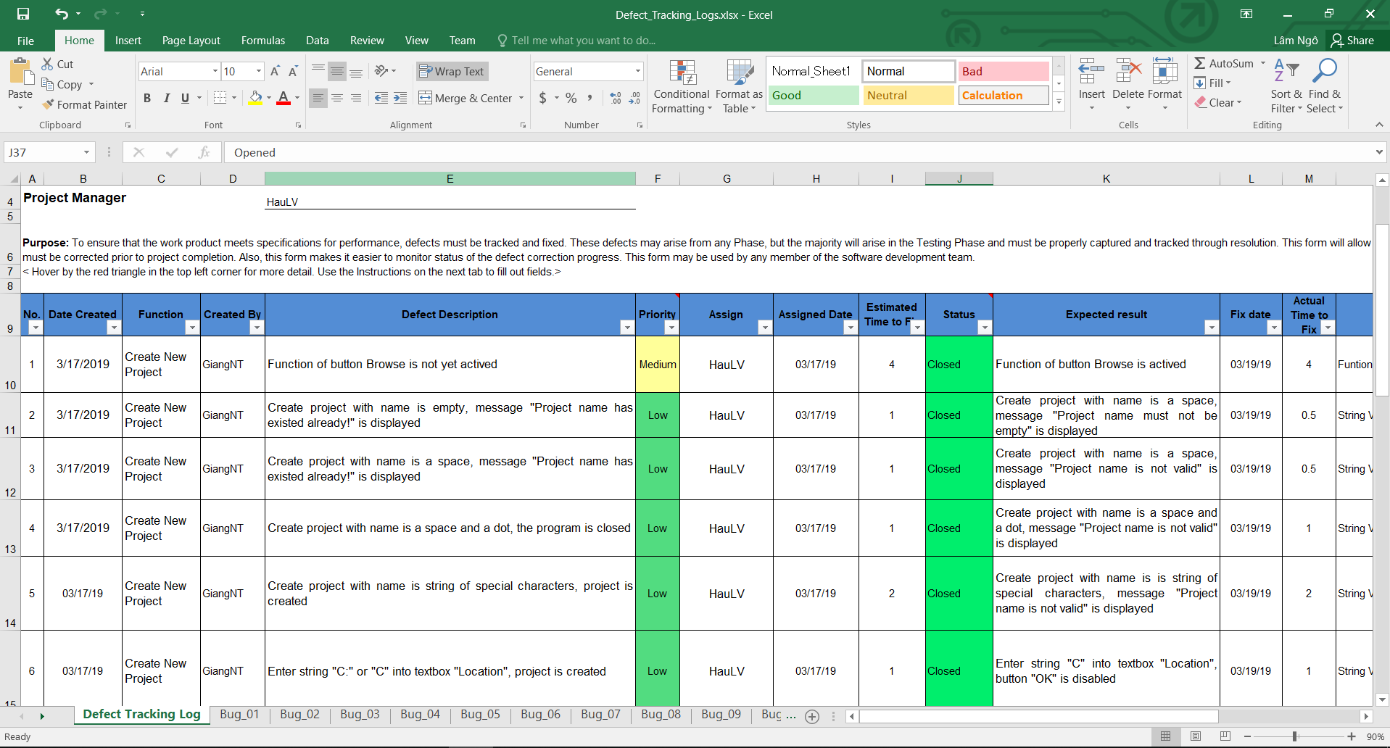
BUG TRACKING

Slide 45
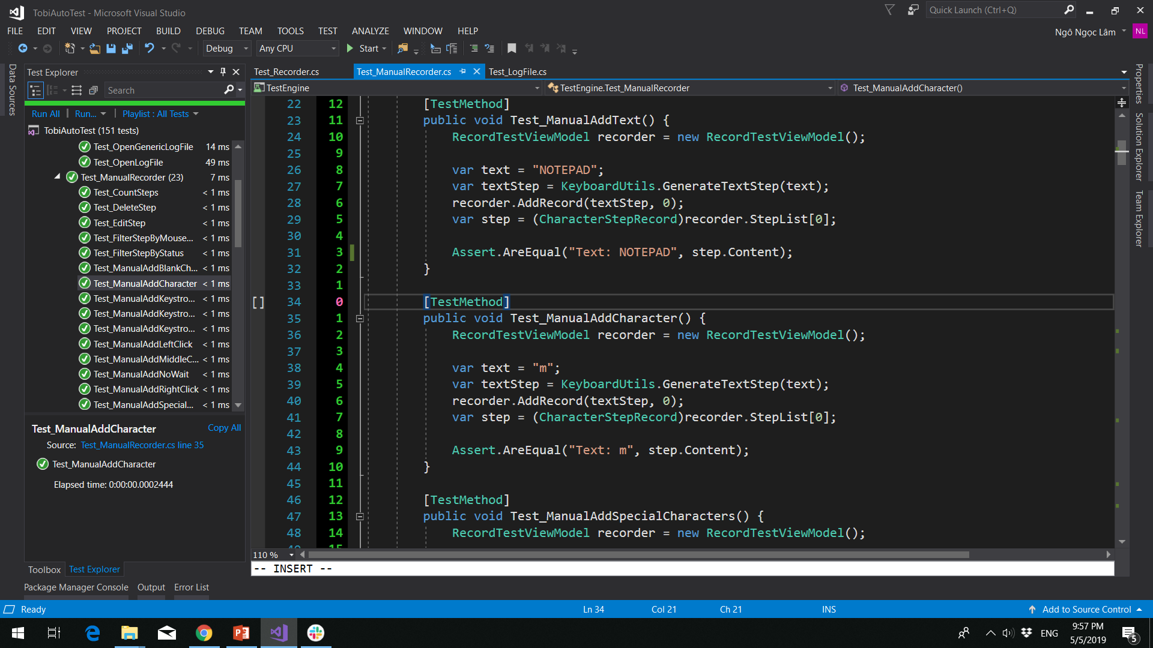
UNIT TEST
Total test cases: 151
Passed: 151
Failed: 0

Slide 46
INTEGRATION TEST
TEST REPORT
Number of test cases | 286
Pass | 286
Fail | 0
Test coverage | 100.00%
Test successful coverage | 100.00%

Slide 47
SYSTEM TEST
TEST REPORT
Number of test cases | 55
Pass | 55
Fail | 0
Test coverage | 100.00%
Test successful coverage | 100.00%

Slide 48
REGRESSION TEST
TEST REPORT
Number of test cases | 286
Pass | 286
Fail | 0
Test coverage | 100.00%
Test successful coverage | 100.00%

Slide 49
SUMMARY
TEST REPORT
Number of test cases | 492
Pass | 492
Fail | 0
Test coverage | 100.00%
Test successful coverage | 100.00%

Slide 50
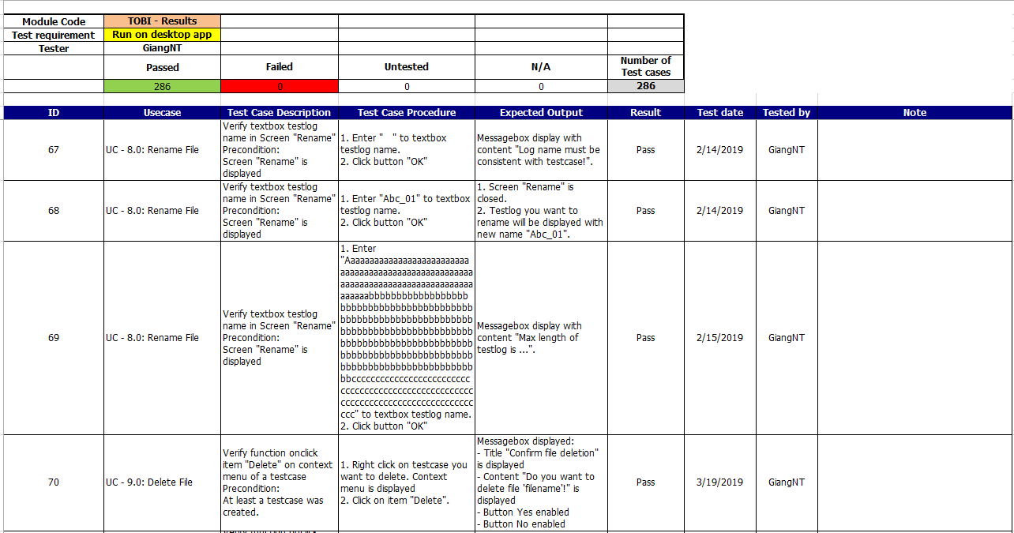
TEST CASE

Slide 51
LESSONS LEARNED

Slide 52
LESSONS LEARNED
Project management
Teamwork
01
02
03
04
New technologies
Business

Slide 53
DEMO & QA

Slide 54
THANK YOU

